Slide 1
data analytics for transfer pricing
Utilising technology and data tools in TP

Slide 2
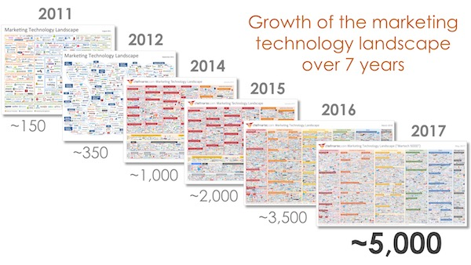
Ever-changing landscape
Source: chiefmartec.com

Slide 3
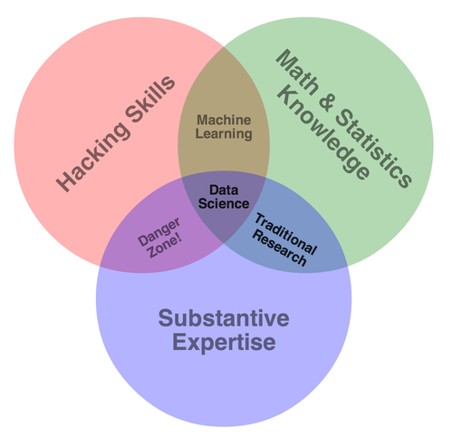
Demystify data
Internal assets: personnel and data
Structured data vs unstructured data –
Subject expertise: tax knowledge and experiences, stats and economics, business acumen
Data-driven decision vs Problem-driven decision
Data privacy
Excel /Database- Tables/Rows/Columns | Text-heavy/Images- Logs, notes, images, emails
Data Science | Stats
Networks, graphs | Model
Weights | Parameters
Learning | Fitting
Supervised/Unsupervised learning | Regression/Clustering

Slide 4
Application in theory
Step 1. Identify problem:
e.g. inconsistent local TP documentation reports
Step 2. Pinpoint repetitive tasks:
e.g. similar transactions in certain countries share similar functional analyses
Step 3. Inspect data resources:
e.g. internal systems for finance, tax and legal, their linkage (or the lack of it)
Step 4. Enquire existing internal data/technology tools:
e.g. coding team, share point project managers, web developers
Step 5: Bridge the gap:
e.g. communication to stakeholders, prepare IT work flow, work with developers
Let stakeholders participate in early stages

Slide 5
Tools available
1. Free open sources tools
Python
R-studio
Built in libraries - Matplotlib/Scikit-learn/Seaborn/numpy/panda
GitHub for version control
…
2. In-house resources
Sharepoint support
Internal coding / IT team
ERP/Databases
…

Slide 6
Case study 1
Automating the process of generating compliance documentation reports
Utilising existing digital assets with detailed discussion with IT
Working on project flow with coders/PMs => user testing/feedback => iteration => repeat

Slide 7
Case study 2
Applying to CBCR analyses:
Data cleansing & construct – discover mismatch, inconsistencies, construct potentially helpful features
Descriptive analyses – overall health check, description of distribution
Deep dive analytics – ratio design, overlay analytics and regressions
Visualisation - presentation in layman terms and single out risk areas
Deep dive analytics
Data cleansing
Descriptive analyses
Predictive modelling
Automation

Slide 8
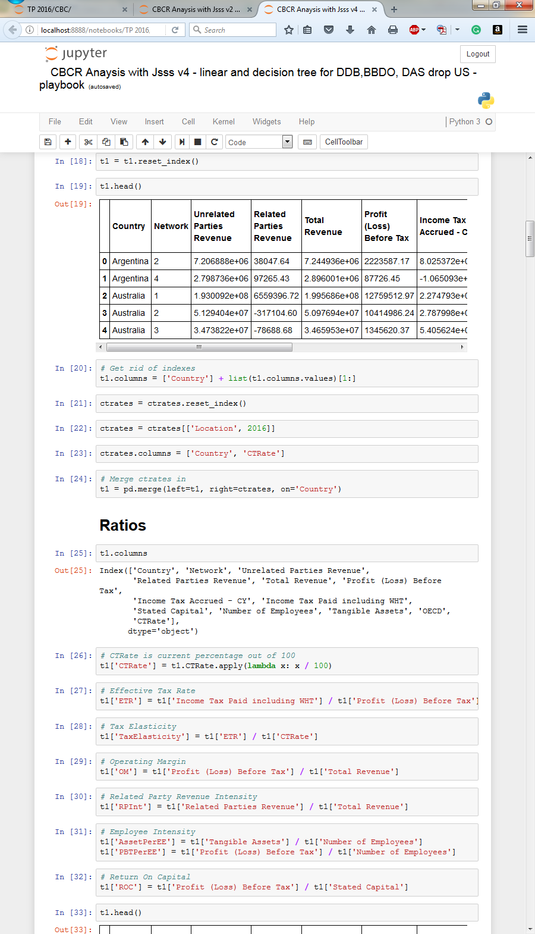
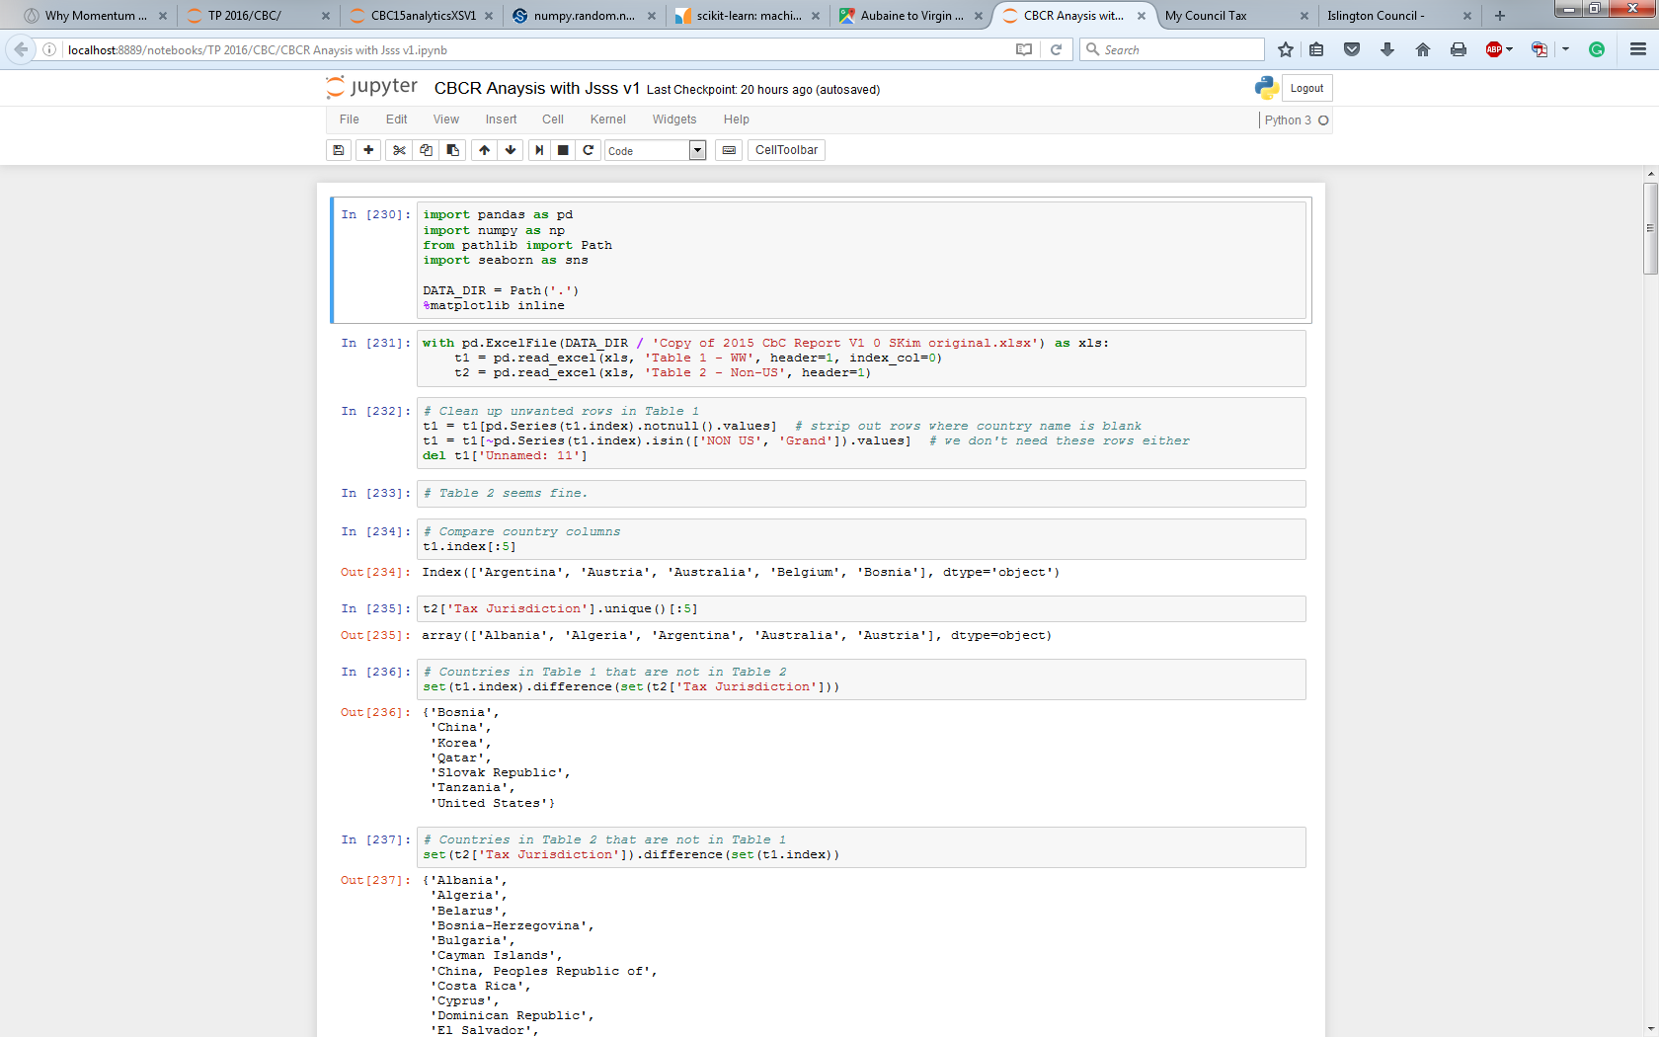
Data cleansing & construct
Looking for inconsistencies, mismatches – this can be very time consuming
Plan ahead - construct useful features such as ratios

Slide 9
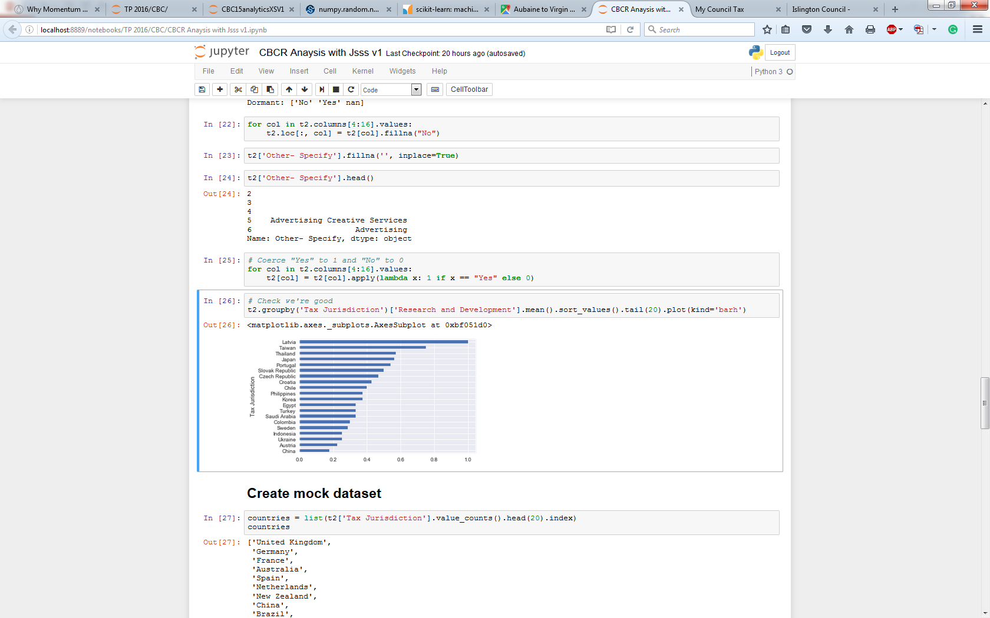
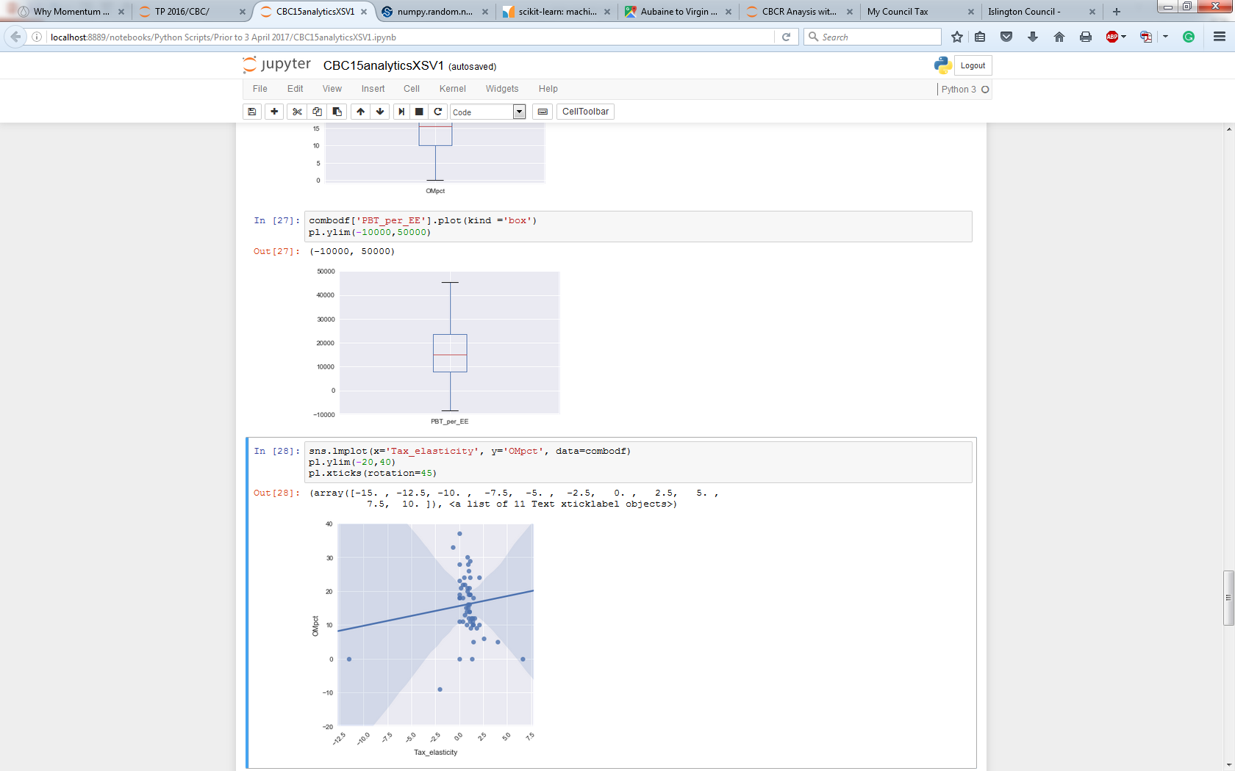
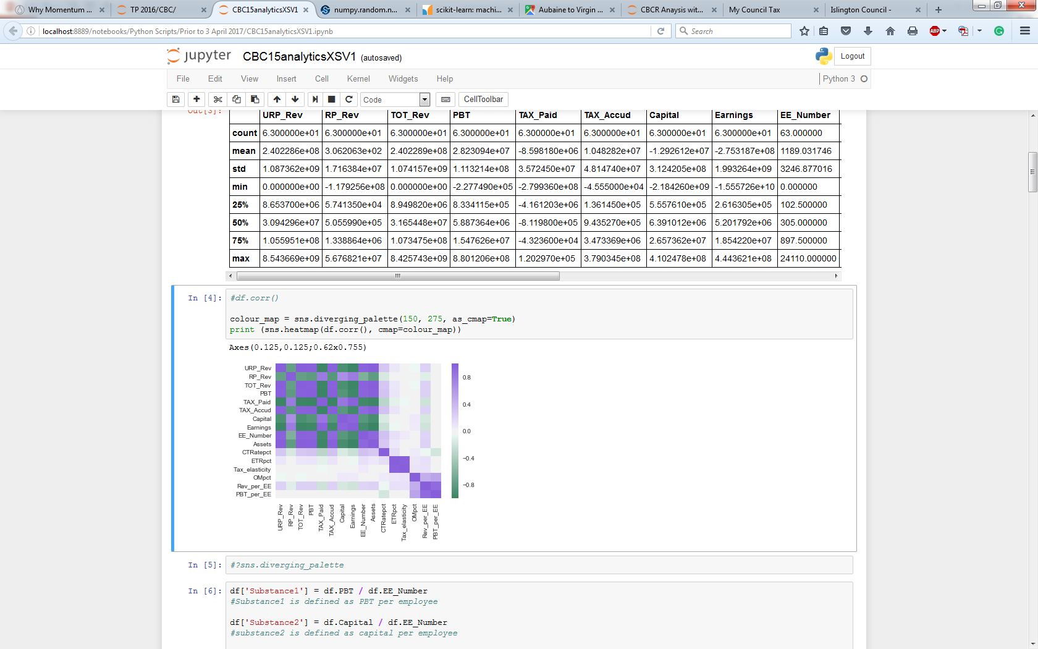
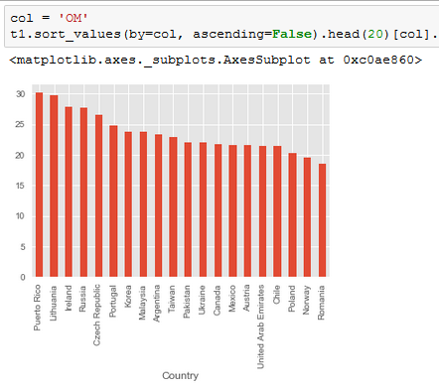
Descriptive analyses

Slide 10
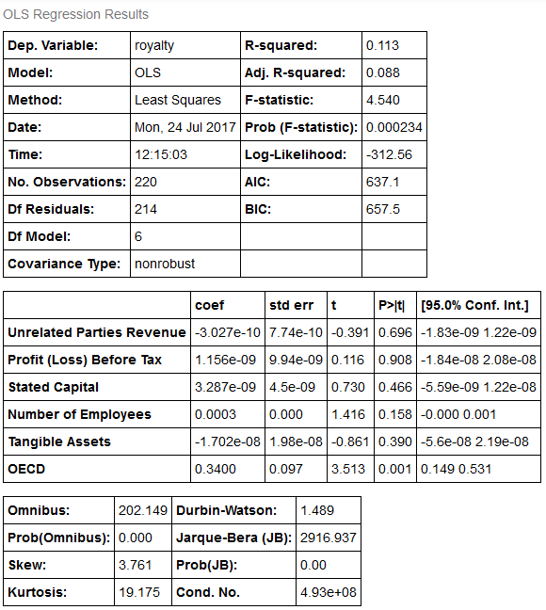
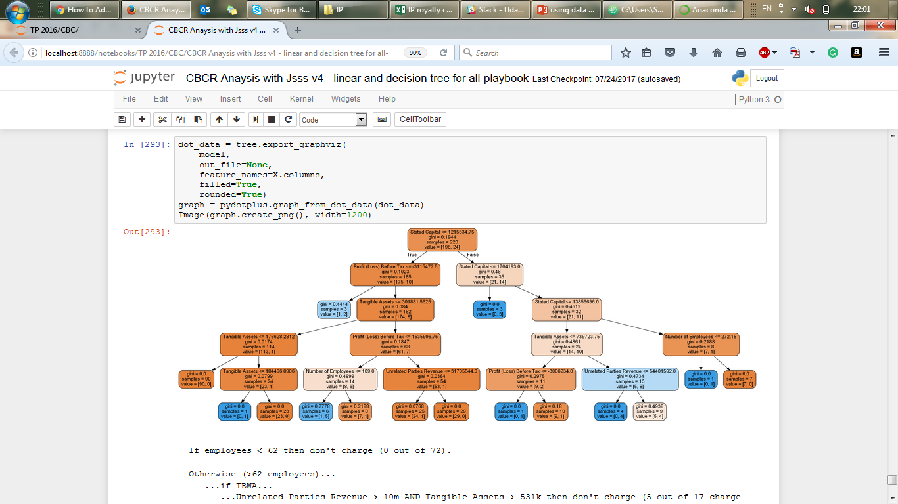
Deep dive analytics
Choose the most suitable model:
Linear regression
Logit regression
Random forest/decision tree
Combining with selection of features/parameters and optimisation techniques

Slide 11
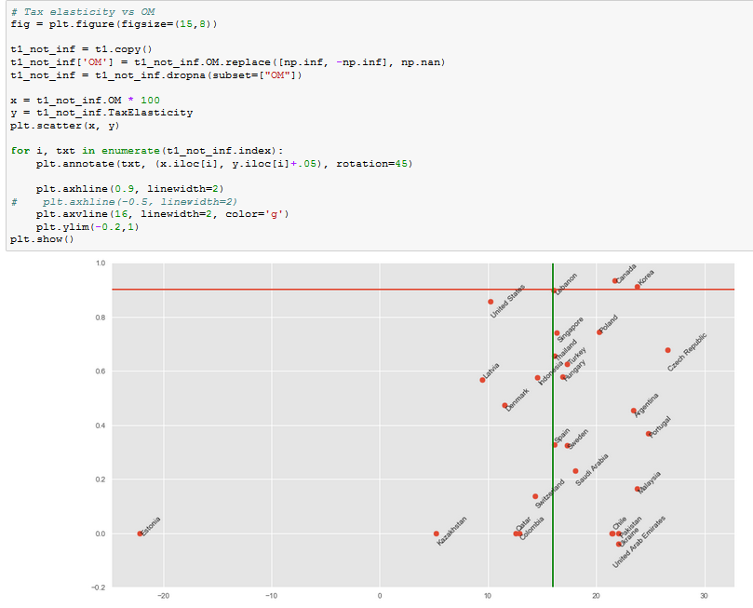
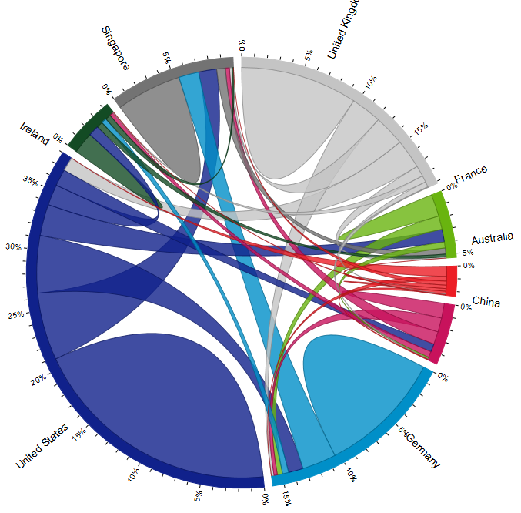
visualisation
Pick the most relevant visual to instantiate discussions
Get all stakeholders involved for ideas – coding is easy
Typically extend to more relevant analytics for business not just CBCR
E.g.1 Tax Elasticity
E.g.2 Transaction Flows for TP in a Chord Diagram

Slide 12
Other opportunities
Compliance
Transfer pricing
Indirect tax
Controversy
Tax planning
Audit risk prediction

